Slide 1



Car Rental System

Slide 2
Name :-DOBARIYA KRISH
Roll No :- 126
Enrolment No :- 23002170210023
Division :- D-5 Branch :- IT
OUR TEAM
Name:-BUTANI MEET
Roll No :- 151
Enrolment No :- 23002170110084
Division :- D-5 Branch :- CE
Name :-VAGADIYA LIZA
Roll No :- 135
Enrolment No :- 23002170110194
Division :- D-5 Branch :- CE
Name:- RUPAPARA MANTHAN
Roll No :- 132
Enrolment No :- 21002170110161
Division :- D-5 Branch :-CE
Name:- RAIYANI PRINCY
Roll No :- 147
Enrolment No :- 23002170110152
Division :- D-5 Branch :- CE

Slide 3
Project Outline
Introduction
Objective
Data Flow Diagrams
Functional Requirements
Merits and Demerits
Future Scope
Conclusion

Slide 4
Introduction
This is a Java Project on Car Rental System which provides a lots of facilities to car rental agency.
It will help the car rental agencies to reduce the paper work and work efficiently.
Through this project, we can add a new car record, delete a car record, and modify its rental price.
This system has different interface for both admin as well as customer.
Admin can make changes on car records such as adding, deleting and modifying where as user can only choose the available car.

Slide 5

Objective
Providing a wide selection of vehicles such as SUV, Economy car, Luxury car, etc.
The rental process should be quick and easy, with minimal paperwork and administrative tasks.
Customers should be able to book a vehicle online.
We should offer competitive pricing to attract customers and also discount if rental period is greater.

Slide 6
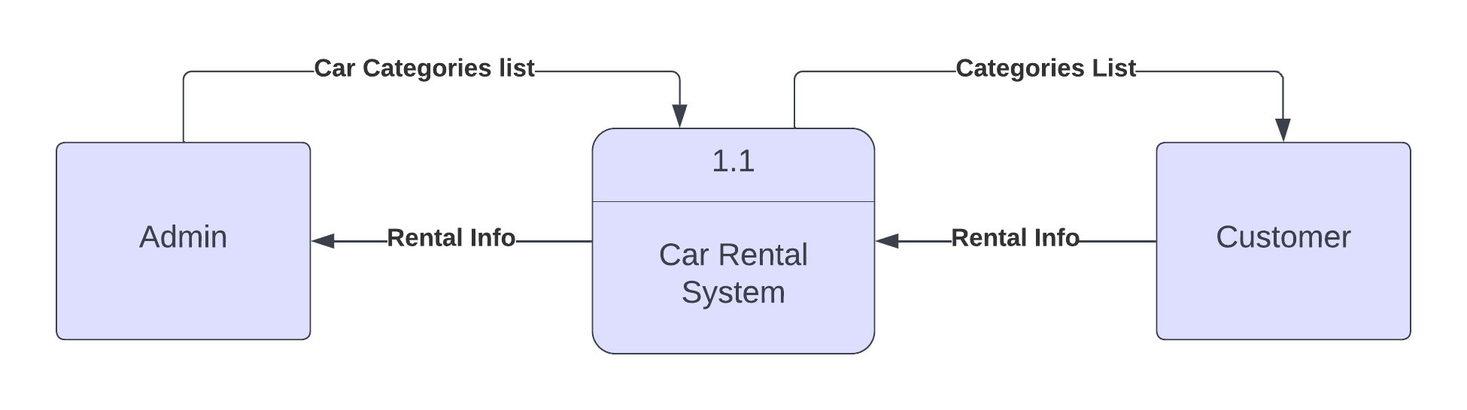
Level 0 Data Flow Diagram

Slide 7
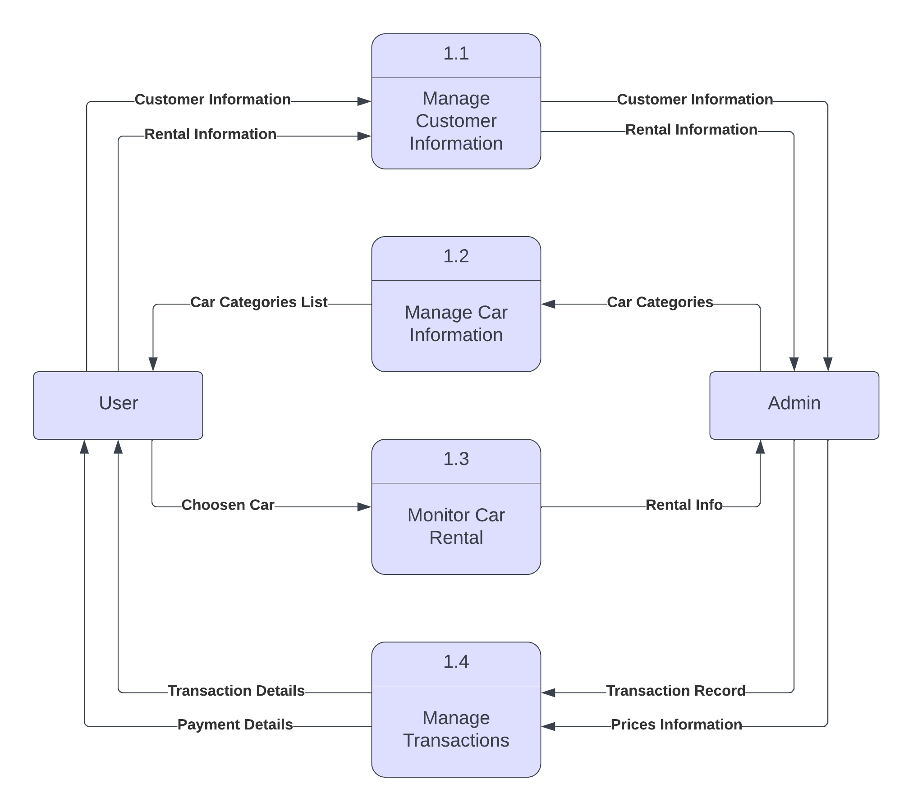
Level 1 Data Flow Diagram

Slide 8
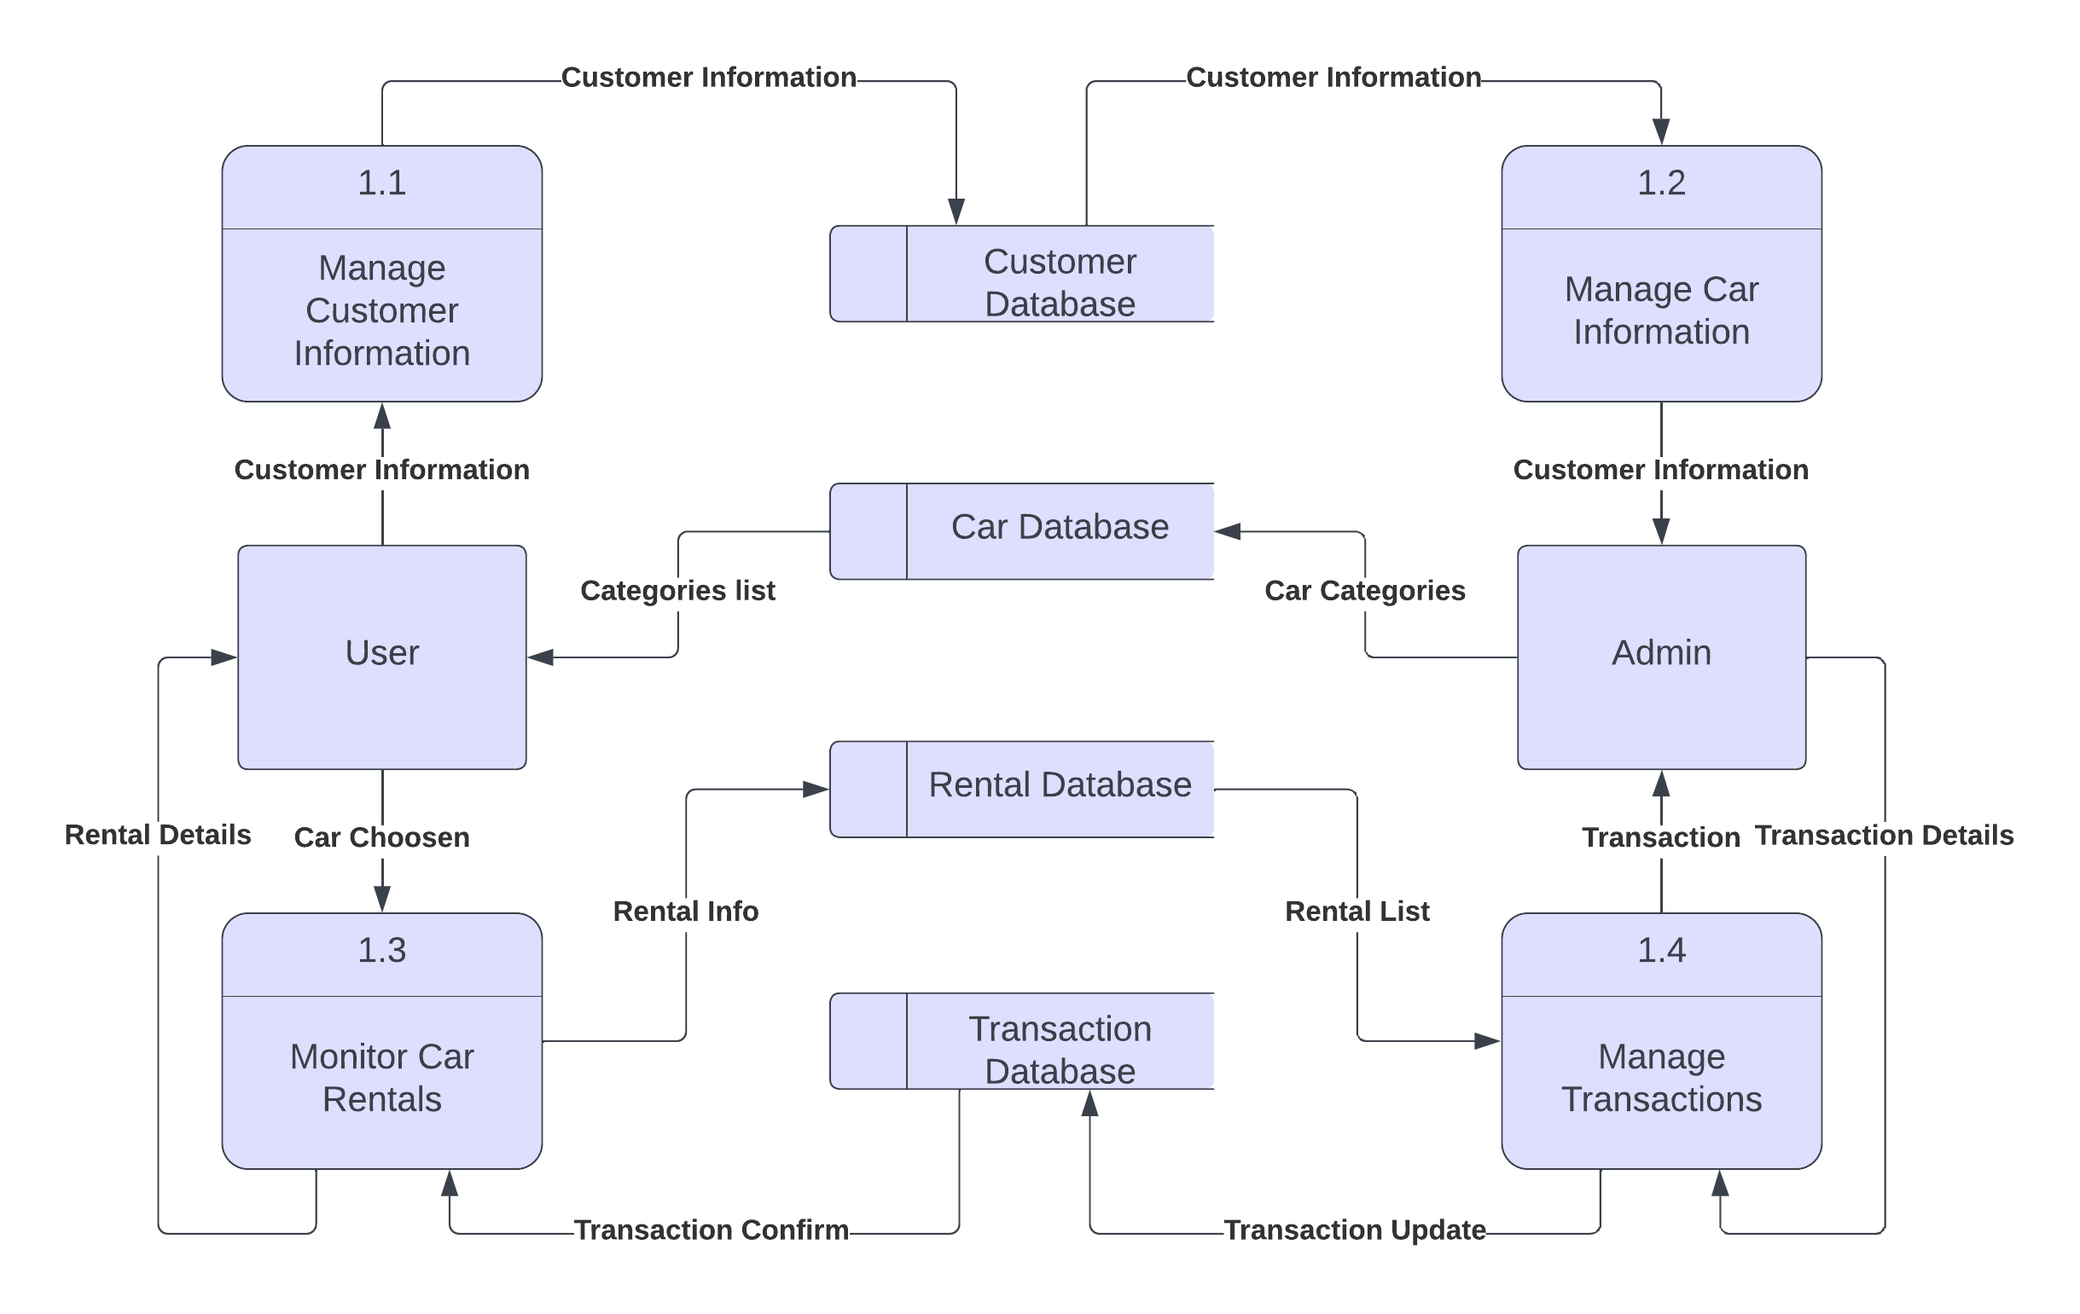
Level 2 Data Flow Diagram

Slide 9

Functional Requirements
This system will allow customers to view the availability of rental vehicles in real-time and reserve the vehicle of their choice.
This system will also allow admin’s to add new car details, delete a car details, and also modify specific car rental price.
This system will allow customers to pay for rentals using various payment methods, such as credit cards or debit cards.
This system will allow customers to search and filter available vehicles by make, model, year, and color.

Slide 10
Merits and Demerits
Merits
Demerits
The car rental system is convenient for travelers who need a car for a short-term trip or for those who don't have a personal vehicle.
We are giving discounts if the rental days are greater to remain in market.
Customers who rent a car do not have to worry about depreciation costs that come with owning a personal car.
During peak seasons or high demand periods, car rental companies may run out of available vehicles, leaving customers stranded.
There can be disputes between the customer and the rental company regarding the extent of damage to the vehicle during the rental period.
Car rental companies may have a limited mileage policy, which can be a disadvantage for customers who need to drive long distances.

Slide 11

Future Scope
As the demand for eco-friendly and self-driving vehicles increases, car rental systems may need to provide electric and autonomous vehicles.
This will require new infrastructure and technology to manage charging, maintenance, and navigation.
Blockchain technology can be used to enhance the security and transparency of rental transactions and reduce the risk of fraud.
Mobile integration will allow customers to easily reserve, rent, and manage vehicles using their smartphones.
This will require the development of user-friendly mobile applications.

Slide 12
Conclusion
A car rental system is an essential tool for rental agencies to manage their reservations, payments, and customer interactions.
A well-designed car rental system can help car rental companies reduce administrative overhead.
The use of a car rental system can help minimize errors and increase accuracy in rental reservations, reducing customer complaints and improving the company's reputation.

Slide 13
THANK YOU…..!!!

